Slide 1

Normalization Theory: 1NF to 5NF
Database Management System | Database Design and Advanced Normalization
Course: Database Management System | Chapter: Database Design and Advanced Normalization | Program: Bachelor of Engineering
DISCOVER · LEARN · EMPOWER
Notes:
Welcome students to this advanced session on database normalization. We will explore the theoretical foundations that ensure data integrity. Our goal is to master the transition from unstructured data to highly optimized schemas. Remember, normalization is the backbone of reliable database design.

Slide 2
Course Outcomes
SLIDE 2 / 14
Course Outcome
CO | BT LEVEL | DESCRIPTION
CO1 | BT2 | Explain database architecture, relational model concepts and formal query language foundations including relational algebra and relational calculus.
CO2 | BT3 | Apply relational algebra, relational calculus and SQL constructs to formulate correct and efficient database queries.
CO3 | BT4 | Analyze functional dependencies and design normalized relational schemas up to 5NF ensuring lossless join and dependency preservation.
CO4 | BT4 | Analyze transaction schedules and concurrency control mechanisms to determine serializability, recoverability and correctness.
CO5 | BT5 | Evaluate storage structures, indexing strategies and query optimization techniques for performance, scalability and reliability.
Chandigarh University
2 / 14
Notes:
This lecture directly supports our course outcomes regarding transaction correctness and performance evaluation. By mastering normalization, you learn to design schemas that support serializable transactions without redundancy. You will also understand how normalized structures influence indexing strategies and query optimization. These skills are critical for building scalable and reliable database systems.

Slide 3
Learning Objectives
SLIDE 3 / 14
Learning Outcomes
1
Analyze functional dependencies to determine the normal form of any relation.
2
Evaluate the necessity of decomposition to eliminate specific data anomalies.
3
Synthesize normalized schemas achieving BCNF to ensure lossless join properties.
4
Assess higher normal forms like 4NF and 5NF for complex multi-valued dependencies.
5
Critique denormalization strategies against the strict requirements of advanced normalization theory.
Chandigarh University
3 / 14
Notes:
By the end of this session, you will be able to analyze any relation for its normal form. You will evaluate when decomposition is necessary to fix update, insertion, or deletion anomalies. We will synthesize schemas that meet BCNF and assess when 4NF or 5NF are required. Finally, you will critique when to deviate from strict normalization for performance.

Slide 4
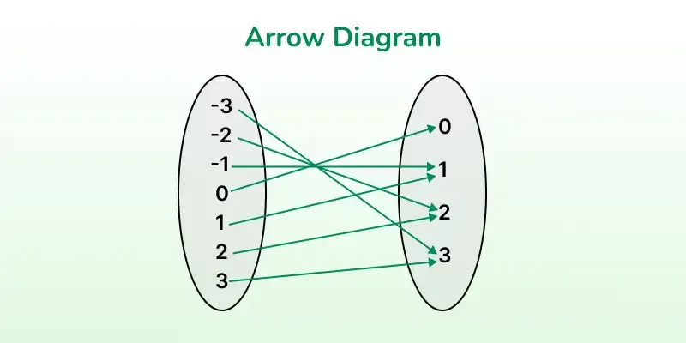
Lecture
SLIDE 4 / 14
Fundamentals of Functional Dependencies
1
A functional dependency X → Y means Y is uniquely determined by X.
2
Trivial dependencies occur when Y is a subset of X in the relation.
3
Non-trivial dependencies require Y to contain attributes not present in X.
4
Full functional dependency exists if no proper subset of X determines Y.
5
Transitive dependency occurs when X → Y and Y → Z implies X → Z.
6
Candidate keys are minimal sets of attributes that uniquely identify every tuple.
Representation of Relations and Functions - GeeksforGeeks
Chandigarh University
4 / 14
Notes:
Functional dependencies are the rules that govern how data relates to itself. If you know the student ID, you automatically know the student name; this is a dependency. A full dependency means you cannot determine the attribute with just part of the key. Transitive dependencies are the root cause of redundancy in poorly designed tables.

Slide 5
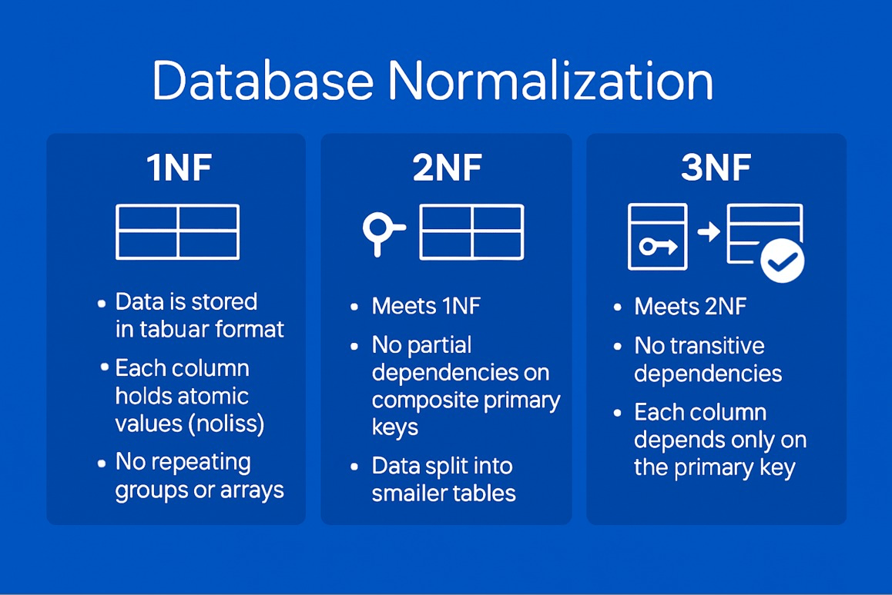
Lecture
SLIDE 5 / 14
First Normal Form (1NF) Requirements
1
1NF requires every attribute to contain only atomic, indivisible values.
2
No repeating groups or arrays are allowed within a single cell.
3
Each row must be unique, typically enforced by a primary key.
4
The order of rows and columns does not affect the logical structure.
5
All attributes must have distinct names within the relation schema.
6
1NF eliminates repeating groups but does not remove all redundancy.
Source: www.digitalocean.com
Chandigarh University
5 / 14
Notes:
First Normal Form is the baseline for any relational database. It simply means no lists inside cells; every value must be atomic. For example, a 'Phone Numbers' column cannot contain '555-1234, 555-5678'. You must split these into separate rows. This ensures the database engine can process each value individually.

Slide 6
Lecture
SLIDE 6 / 14
Second Normal Form (2NF) and Partial Dependencies
1
A relation is in 2NF if it is in 1NF and has no partial dependencies.
2
Partial dependency occurs when a non-key attribute depends on part of a composite key.
3
Decomposition splits the table to isolate attributes depending on the full key.
4
2NF eliminates redundancy caused by attributes depending on only a subset of the key.
5
All non-key attributes must be fully functionally dependent on the primary key.
6
Relations with a single attribute primary key are automatically in 2NF.
Chandigarh University
6 / 14
Notes:
Second Normal Form addresses redundancy in tables with composite keys. If a student ID and course ID form the key, but the course name depends only on the course ID, that is a partial dependency. We must move the course details to a separate table. This ensures that every non-key attribute relies on the entire primary key.

Slide 7
Lecture
SLIDE 7 / 14
Third Normal Form (3NF) and Transitive Dependencies
1
A relation is in 3NF if it is in 2NF and has no transitive dependencies.
2
Transitive dependency exists when a non-key attribute depends on another non-key attribute.
3
3NF ensures all non-key attributes depend directly on the primary key only.
4
Decomposition removes attributes that create indirect chains of dependencies.
5
3NF eliminates update anomalies caused by changing data in intermediate attributes.
6
Every non-prime attribute must be non-transitively dependent on every candidate key.
Chandigarh University
7 / 14
Notes:
Third Normal Form tackles transitive dependencies where data depends on other non-key data. For instance, if City determines Zip Code, and Student determines City, the Zip Code depends on the Student indirectly. We move City and Zip to a separate table. This prevents errors where updating a city name requires changing multiple rows.

Slide 8
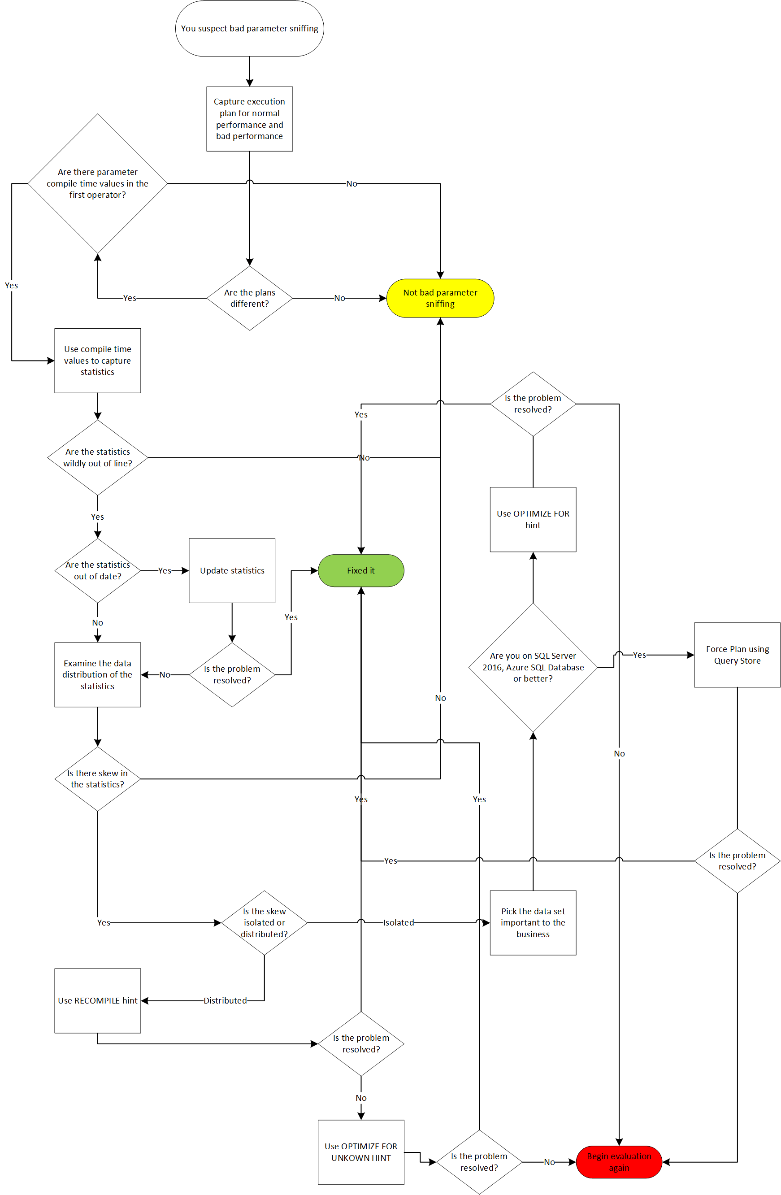
Lecture
SLIDE 8 / 14
Boyce-Codd Normal Form (BCNF) Definition
1
BCNF is a stricter version of 3NF requiring all determinants to be candidate keys.
2
A relation is in BCNF if for every dependency X → Y, X is a superkey.
3
BCNF eliminates anomalies that 3NF cannot resolve in complex dependency scenarios.
4
Every determinant in the relation must uniquely identify the entire tuple.
5
BCNF ensures that no non-trivial dependency exists where the left side is not a key.
6
Achieving BCNF may sometimes sacrifice dependency preservation for lossless joins.
Source: i0.wp.com
Chandigarh University
8 / 14
Notes:
Boyce-Codd Normal Form is a stricter version of 3NF. In 3NF, we allow dependencies where the determinant is a candidate key. In BCNF, every determinant must be a candidate key. This handles cases where a table has multiple overlapping candidate keys. It ensures that no attribute determines another unless it is a key itself.

Slide 9
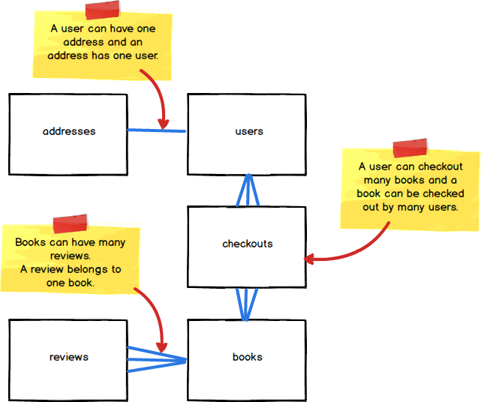
Worked Example
SLIDE 9 / 14
Achieving BCNF
1
Consider relation R(A, B, C) with dependencies A → B and B → C.
2
Candidate key is A, but B → C violates BCNF because B is not a key.
3
Decompose R into R1(A, B) and R2(B, C) to satisfy BCNF requirements.
4
R1 contains A → B where A is the key for R1.
5
R2 contains B → C where B is the key for R2.
6
The join of R1 and R2 on B reconstructs the original data losslessly.
Source: d186loudes4jlv.cloudfront.net
Chandigarh University
9 / 14
Notes:
Let's look at a concrete example. We have A determining B, and B determining C. The key is A, but B determines C, and B is not a key. This violates BCNF. We split the table into R1 with A and B, and R2 with B and C. Now, in R1, A is the key. In R2, B is the key. Both tables are in BCNF.

Slide 10
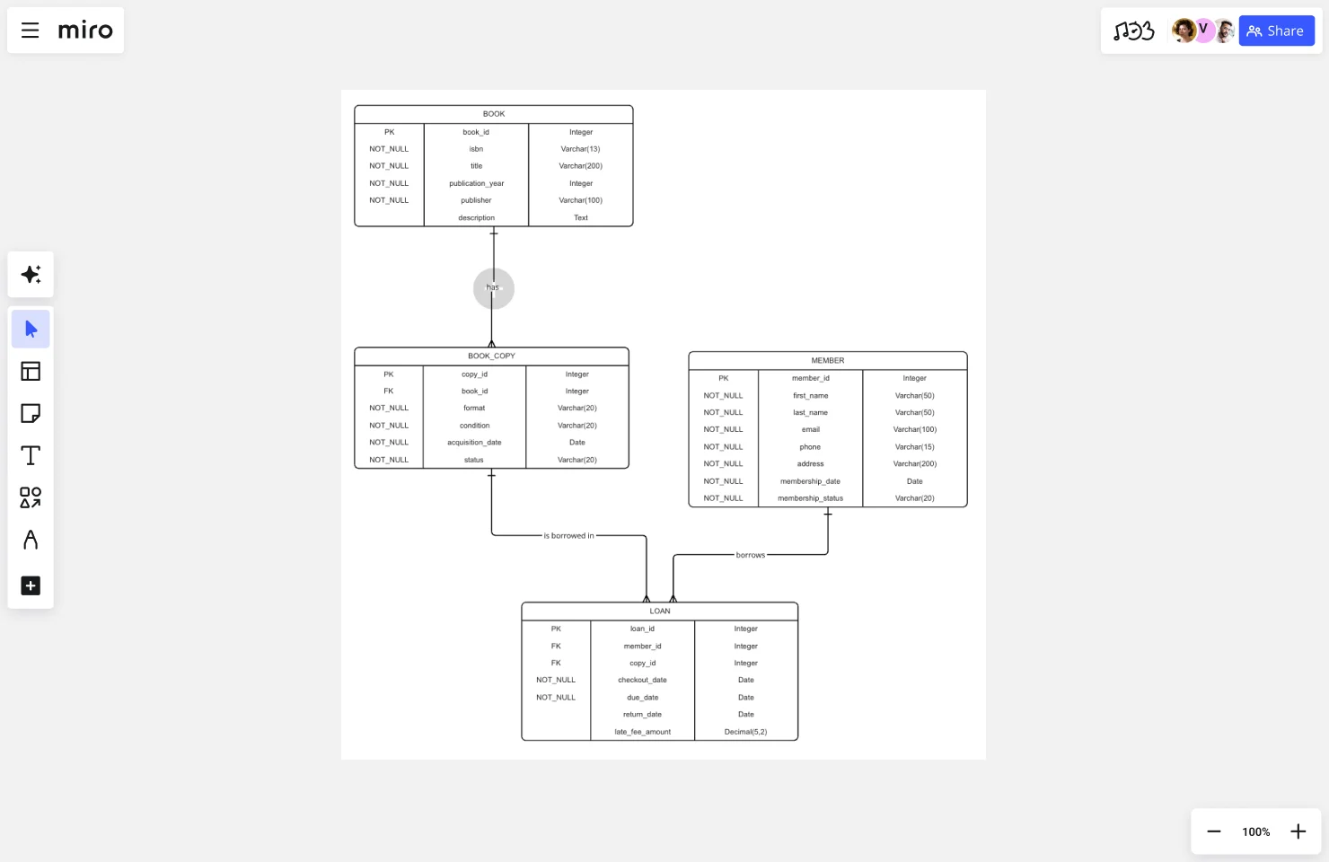
Lecture
SLIDE 10 / 14
Fourth Normal Form (4NF) and Multivalued Dependencies
1
4NF eliminates non-trivial multivalued dependencies where X →→ Y holds.
2
A multivalued dependency exists if for a value of X, there are multiple independent Y values.
3
4NF requires that every non-trivial multivalued dependency has a superkey as the determinant.
4
It prevents redundancy when two independent sets of values exist for a single key.
5
4NF is achieved if the relation is in BCNF and has no multivalued dependencies.
6
Common in scenarios like a professor teaching multiple courses and research areas.
Source: images.ctfassets.net
Chandigarh University
10 / 14
Notes:
Fourth Normal Form deals with multivalued dependencies. Imagine a professor who teaches multiple courses and has multiple research interests. If we store this in one table, we get a Cartesian product of courses and research areas. This creates massive redundancy. 4NF requires us to separate these independent facts into different tables.

Slide 11
Lecture
SLIDE 11 / 14
Fifth Normal Form (5NF) and Join Dependencies
1
5NF addresses join dependencies where a relation must be decomposed to avoid redundancy.
2
A join dependency holds if a relation can be reconstructed by joining its projections.
3
5NF requires that every join dependency is implied by the candidate keys.
4
It handles complex scenarios involving three or more interrelated tables.
5
Decomposition in 5NF ensures that no spurious tuples are generated upon joining.
6
Also known as Project-Join Normal Form (PJNF) in theoretical contexts.
Chandigarh University
11 / 14
Notes:
Fifth Normal Form is the most advanced level. It handles situations where a relation can be broken down into three or more tables. If you join these tables back together, you must get exactly the original data without any spurious rows. This is crucial for complex business rules involving multiple entities.

Slide 12
Lecture
SLIDE 12 / 14
Common Pitfalls in Normalization Design
1
Over-normalization can lead to excessive joins and degraded query performance.
2
Ignoring functional dependencies results in persistent data redundancy and anomalies.
3
Failing to identify candidate keys leads to incorrect decomposition strategies.
4
Assuming 3NF is always sufficient ignores complex multivalued dependencies.
5
Neglecting lossless join property causes data loss during table reconstruction.
6
Prioritizing performance over integrity without analysis creates inconsistent data states.
Chandigarh University
12 / 14
Notes:
There are common pitfalls you must avoid. Over-normalization can make queries slow because you have to join too many tables. Ignoring dependencies means you will still have redundancy. Always check for lossless joins; otherwise, you lose data when you reconstruct the table. Sometimes, you must denormalize for performance, but do so intentionally.

Slide 13
Lecture
SLIDE 13 / 14
Key Takeaways
1
Normalization systematically eliminates redundancy through functional and multivalued dependencies.
2
1NF ensures atomic values, while 2NF removes partial dependencies on composite keys.
3
3NF eliminates transitive dependencies, and BCNF enforces stricter key constraints.
4
4NF and 5NF address complex multivalued and join dependencies respectively.
5
Designers must balance normalization with performance requirements for real-world systems.
Chandigarh University
13 / 14
Notes:
To summarize, normalization is a systematic process to remove redundancy. We start with 1NF for atomic values and move up to 5NF for complex dependencies. Each form addresses specific types of anomalies. Remember that while normalization ensures integrity, you must balance it with performance needs in practical applications.

Slide 14
Lecture
SLIDE 14 / 14
References
1
Fundamentals of Database Systems — Ramez Elmasri & Shamkant B. Navathe
2
Database System Concepts — Silberschatz, Korth & Sudarshan
3
Database Management Systems — Raghu Ramakrishnan & Johannes Gehrke
4
Oracle/MySQL Documentation — Oracle
Chandigarh University
14 / 14
Notes:
These are the standard texts you should consult for deeper understanding. Elmasri and Navathe provide excellent theoretical foundations. Silberschatz offers a comprehensive view of system concepts. Ramakrishnan and Oracle documentation are essential for practical implementation details. Please review these chapters before your next assignment.

